Slide 1
OBJECT ORIENTED PROGRAMMING
By:
Zalili Binti Musa
Rozlina Mohammed

Slide 2
OUTLINE
Overview on a class diagram
Several relationship among class
Skeleton code generation based on a given class / design

Slide 3
What is OOP?
OOP is a design philosophy. It stands for Object Oriented Programming. Object-Oriented Programming (OOP) uses a different set of programming languages than old procedural programming languages (C, Pascal, etc.). Everything in OOP is grouped as self sustainable "objects". Hence, you gain re-usability by means of four main object-oriented programming concepts.

Slide 4
What is OOP?
n order to clearly understand the object orientation, let’s take your “hand” as an example. The “hand” is a class. Your body has two objects of type hand, named left hand and right hand. Their main functions are controlled/ managed by a set of electrical signals sent through your shoulders (through an interface). So the shoulder is an interface which your body uses to interact with your hands. The hand is a well architected class. The hand is being re-used to create the left hand and the right hand by slightly changing the properties of it.

Slide 5
UML Design
Subject Registration
Subject
Student
Has a
Is a
Association
Enrollment
Inheritance
Aggregation
7 July 2010
Room
Department
Department
Control
The Subject
Composition
Diploma
Bachelor
Part of
Building

Slide 6
Relationships among Classes
Association
Aggregation
Composition
Inheritance

Slide 7
Association
Association represents a general binary relationship that describes an activity between two classes.
An association is usually represented as a data field in the class.

Slide 8
Aggregation
Whole-to-part associations
The concept representing the whole is called the aggregate; each concept representing a part is called constituent.
The aggregate and the constituent may existed independently of each other.

Slide 9
Example of Aggregation
Student Club
1 ... *
1 ... *
1
1 ... *
Advisor
Member

Slide 10
Composition
Whole-to-part associations
The concept representing the whole is called the composite; each concept representing a part is called component
The composite does not exist independently from its component
The component may exist without the composite

Slide 11
Example of Composition
Chair
1
1
1
2
Frame
Back
Seat
Arm Rest

Slide 12
Aggregation vs Composition
 | AGGREGATION | COMPOSITION
Name of whole | Aggregate | Composite
Name of part | Constituent | Component
Parts | May be different types | Usually the same type
Existence | May exist without its parts | Does not exist without its parts
Number of wholes to which a part may belong | Part may belong to more than one aggregate at a time | Part may belong to only one composite at a time

Slide 13
Class
A class is nothing but a blueprint or a template for creating different objects which defines its properties and behaviors. Java class objects exhibit the properties and behaviors defined by its class. A class can contain fields and methods to describe the behavior of an object.

Slide 14
Class
Class name
Start with capital letter for each new word
Example : Student, StudentAdvisory
Attributes
Represent the characteristics of the object
Variables,
Operation
Represent the behavior of the class
Methods, behaviors

Slide 15
Class/Attribute/Method/Object
Student
Class
name
age
course
fees
Attribute
(variable)
registerSubject
withdrawSubject
borrowBook
Method
(operation)
Object
Object
StdDiploma
Std1

Slide 16
Java Code : Class, Attribute, Method Declaration
public class Student { // class name
String name; // attribute @ variable declaration
int age =10;
String course = “DCS” ;
double fees = 1067.60;
public void registerSubject (){
// code for register subject
}
…
}

Slide 17
CLASS DIAGRAM
SUBJECT
//Data member Name Code Credit Contact Hour Course Type Program Level
//Method RegisterSubject Insert Delete Edit
SUBJECT
//Data member name:String code:String credit:int contact_Hour:int course_type:String program_level:String
//Method registerSubject( ): void insert( ): int delete( ): int edit( ): int

Slide 18
Sample form
Student ID
Subject Code
Register Subject

Slide 19
CLASS DIAGRAM
SUBJECT
//Data member - name:String - subjectCode:String - credit:int - contact_Hour:int - course_type:String - program_level:String
//Method + registerSubject( ): void + InsertToDb(String studentID, String subjectCode ): int + Delete(String studentID, String subjectCode ): int + Edit(String studentID, String subjectCode ): int

Slide 20
Sample code
/*
* To change this template, choose Tools | Templates
* and open the template in the editor.
*/
package subject;
/**
*
* @author ADMIN
*/
public class subject {
// Attributes
String name;
String subjectCode;
int credit;
int contactHour;
String programLevel;
/**
* register for subject
*/
public void registerSubject (){
// get the student ID from the text box
// get the subject code from the text box
// call insertToDB function to add the registration info
}
public int insertToDB (String studentID, String subjectCode){
// SQL statement to insert a new data to REGISTERATION table
}
}

Slide 21
Constructing objects with new
class Car {
String licensePlate; // e.g. "New York 543 A23"
double speed; // in kilometers per hour
double maxSpeed; // in kilometers per hour
}
To instantiate an object in Java, use the keyword new followed by a call to the class's constructor. Here's how you'd create a new Car variable called c:
Car c; c = new Car(); The first word, Car, declares the type of the variable c. Classes are types and variables of a class type need to be declared just like variables that are ints or doubles.

Slide 22
Java Code : Object Declaration / Manipulation
public Class Student{
…
public static void main (String data[]){
Student stdDiploma ; // declaring/creating an object
stdDiploma = new Student() ; // object initialize
Student Std1 = new Student() ; // declaration and initialize
Std1.name = " Amad“ ; // assigning value to object
Std1.age = 24 ; // assigning value to object
System.out.println(" student name : " + Std1.name) ;
System.out.println(" student age registration : " + Std1.age) ;
}
}

Slide 23
Access Modifiers
Access Modifiers
1. private 2. protected 3. default 4. public

Slide 24
Access Modifiers
The private (most restrictive) fields or methods cannot be used for classes and Interfaces. It also cannot be used for fields and methods within an interface. Fields, methods or constructors declared private are strictly controlled, which means they cannot be accesses by anywhere outside the enclosing class. A standard design strategy is to make all fields private and provide public getter methods for them.
Data members are usually kept private
It is accessible only within the class

Slide 25
Access Modifiers
public access modifier
The methods which expose the behavior of the object are kept public
Fields, methods and constructors declared public (least restrictive) within a public class are visible to any class in the Java program, whether these classes are in the same package or in another package.
Key feature of OOP
Encapsulation (binding of code and data together)
State (data) is hidden and Behavior (methods) is exposed to external world

Slide 26
Access Modifiers
protected access modifier
The protected fields or methods cannot be used for classes and Interfaces. It also cannot be used for fields and methods within an interface. Fields, methods and constructors declared protected in a superclass can be accessed only by subclasses in other packages. Classes in the same package can also access protected fields, methods and constructors as well, even if they are not a subclass of the protected member’s class.

Slide 27
Static Classes
A class can be declared static, indicating that it contains only static members. It is not possible to create instances of a static class using the new keyword.
The main features of a static class are:
They only contain static members.
They cannot be instantiated.
They are sealed.
They cannot contain Instance Constructors (C# Programming Guide).

Slide 28
Static Classes
Creating a static class is therefore much the same as creating a class that contains only static members and a private constructor. A private constructor prevents the class from being instantiated.
The advantage of using a static class is that the compiler can check to make sure that no instance members are accidentally added. The compiler will guarantee that instances of this class cannot be created.
Static classes are sealed and therefore cannot be inherited. Static classes cannot contain a constructor, although it is still possible to declare a static constructor to assign initial values or set up some static state. For more information, see Static Constructors (C# Programming Guide).

Slide 29
Static/Class Method
There are two types of methods.
Instance methods are associated with an object and use the instance variables of that object. This is the default.
Static methods use no instance variables of any object of the class they are defined in. If you define a method to be static, you will be given a rude message by the compiler if you try to access any instance variables. You can access static variables, but except for constants, this is unusual. Static methods typically take all they data from parameters and compute something from those parameters, with no reference to variables. This is typical of methods which do some kind of generic calculation. A good example of this are the many utility methods in the predefined Math class.

Slide 30
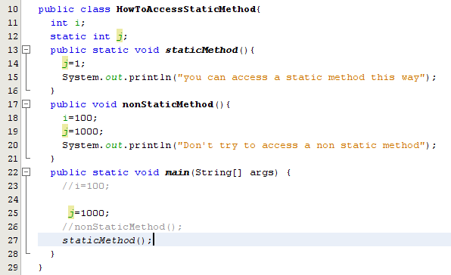
Static/Class Method

Slide 31
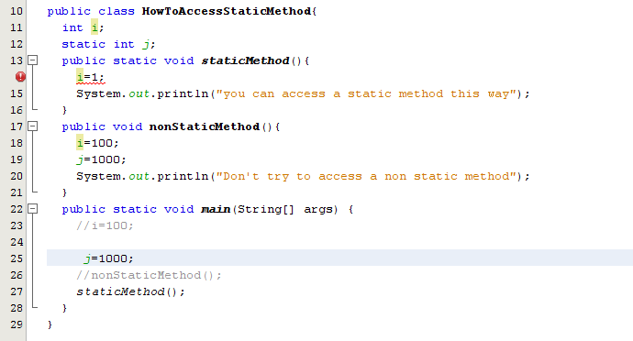
Static/Class Method

Slide 32
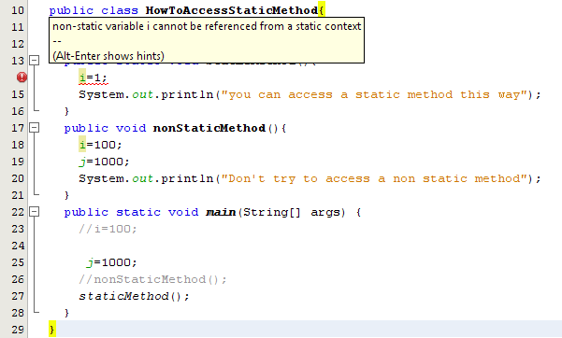
Static/Class Method

Slide 33
Constructors
When you create a new instance (a new object) of a class using the new keyword, a constructor for that class is called. Constructors are used to initialize the instance variables (fields) of an object. Constructors are similar to methods, but with some important differences.
Constructor name is class name. A constructors must have the same name as the class its in.
Default constructor. If you don't define a constructor for a class, a default parameterless constructor is automatically created by the compiler. The default constructor calls the default parent constructor (super()) and initializes all instance variables to default value (zero for numeric types, null for object references, and false for booleans).
Default constructor is created only if there are no constructors. If you define any constructor for your class, no default constructor is automatically created.

Slide 34
Constructors
Differences between methods and constructors.
There is no return type given in a constructor signature (header). The value is this object itself so there is no need to indicate a return value.
There is no return statement in the body of the constructor.
The first line of a constructor must either be a call on another constructor in the same class (using this), or a call on the superclass constructor (using super). If the first line is neither of these, the compiler automatically inserts a call to the parameterless super class constructor.
These differences in syntax between a constructor and method are sometimes hard to see when looking at the source. It would have been better to have had a keyword to clearly mark constructors as some languages do.
this(...) - Calls another constructor in same class. Often a constructor with few parameters will call a constructor with more parameters, giving default values for the missing parameters. Use this to call other constructors in the same class. super(...). Use super to call a constructor in a parent class. Calling the constructor for the superclass must be the first statement in the body of a constructor. If you are satisfied with the default constructor in the superclass, there is no need to make a call to it because it will be supplied automatically.

Slide 35
Constructors
public class Cube1 {
int length ;
int breadth ;
int height ;
public int getVolume( ) {
return ( length * breadth * height );
}
Cube1(){
length = 10;
breadth = 10;
height = 10;
}
Cube1(int l, int b, int h){
length = l;
breadth = b;
height = h;
}
public static void main(String[] args) {
Cube1 cubeObj1, cubeObj2;
cubeObj1 = new Cube1();
cubeObj2 = new Cube1(10, 20, 30);
System.out.println("Volume of Cube1 is : "+cubeObj1.getVolume());
System.out.println("Volume of Cube2 is : "+cubeObj2.getVolume());
}
}

